Slide 1
The input Tag
Tutorial #17

Slide 2
OBJECTIVE

Slide 3
Objective
By the end of this tutorial, you should understand how to use the input tag to get some basic information from an end user.

Slide 4
TEXTPLANATION

Slide 5
Textplanation
The web is a highly interactive environment. That means that the user needs to communicate with the page and the page needs to react and respond to the user. We’ve been playing around with that a bit. After all, button clicks and hyperlinks are a form of interaction, but they’re restrictive. It’s the page saying, “Tell me when you want me to do this thing.”

Slide 6
Textplanation
If we give the user the ability to input text, we grant the user the ability to customize his or her own interactive experience.

Slide 7
Textplanation
Note: Giving the user too much freedom is a terrible security risk. People are terrible creatures who are looking to vandalize your site and corrupt your data.

Slide 8
Textplanation
Most web pages use forms to get information from users. That information is sent to a server, where it is processed. The response is then sent back to the client (that’s the user’s machine) with all of the nasty security stuff handled and removed. There are certain user controls that are used with forms. They don’t have to be used with forms, however. As the web has grown, and tools have expanded, many HTML tags have been repurposed.

Slide 9
Textplanation
The <input> tag is the primary tag used for gathering information from the user. It has a variety of shapes, including text boxes, radio buttons, check boxes, etc… We’re going to stick with two for the time being. Text and checkboxes. These are the easiest to work with and, quite frankly, can handle just about anything we’ll need to do for the time being.

Slide 10
Textplanation
An <input> tag is a self closing tag, which means that there’s no innerHTML. It has one very important attribute. The type will be either “text” or “checkbox” (I’ll let you figure out which creates which). The box will appear differently based on this value. You’ll see how to use them, and the different attributes that affect them, during the construction.

Slide 11
CONSTRUCTION

Slide 12
Construction
Create a folder somewhere on your drive and label it Input Tag.
Open up notepad++.
Save the empty file to your folder and name the file “index.html”.
All first pages on a website are called index.
As you go through the images of the construction, add to your code. You will see comments with explanations of what you are doing. Those comments will change with each slide. You should not type my comments into your code.

Slide 13
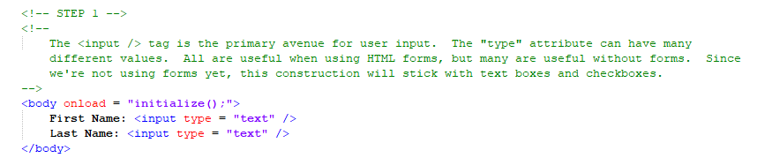
Construction

Slide 14
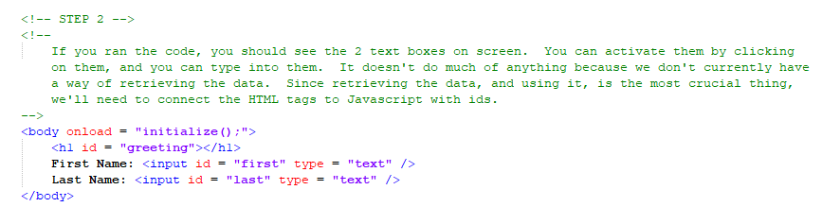
Construction

Slide 15
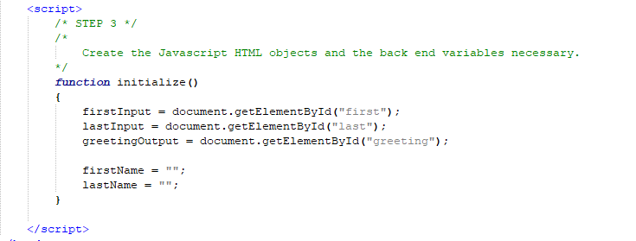
Construction

Slide 16
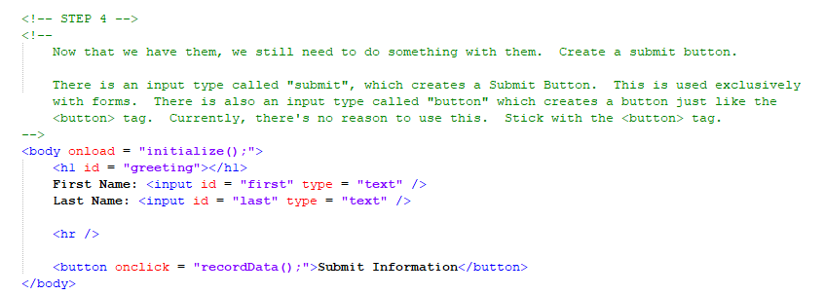
Construction

Slide 17
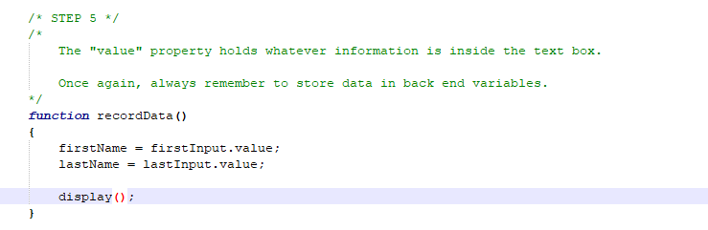
Construction

Slide 18
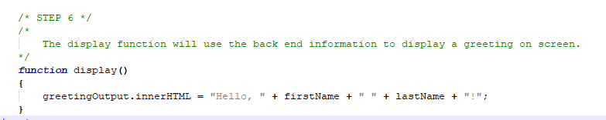
Construction

Slide 19
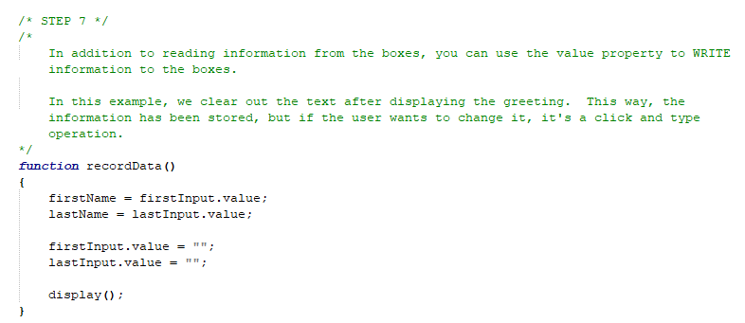
Construction

Slide 20
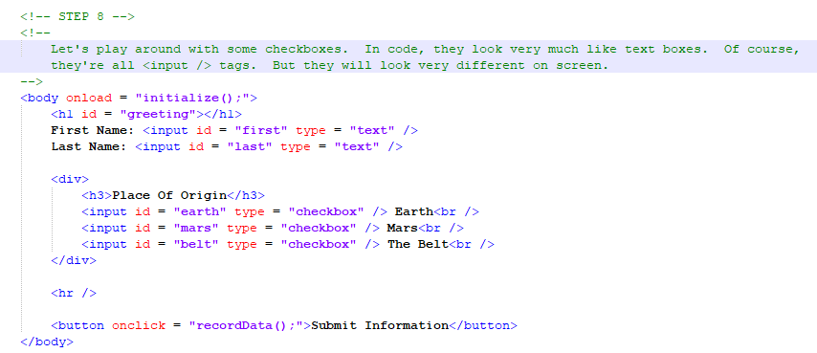
Construction

Slide 21
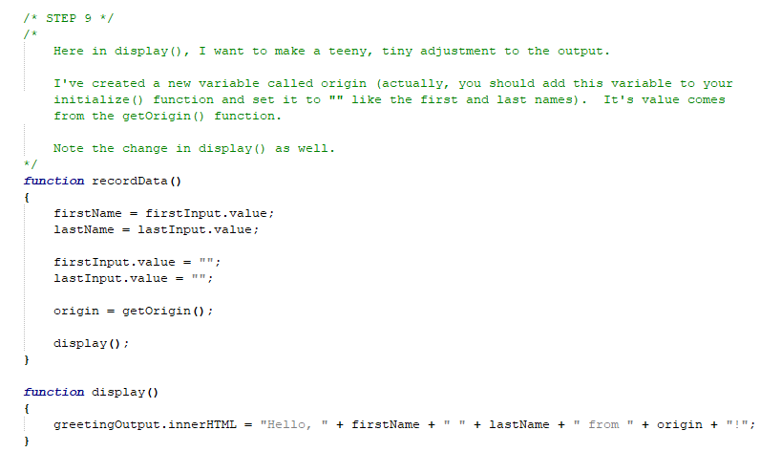
Construction

Slide 22
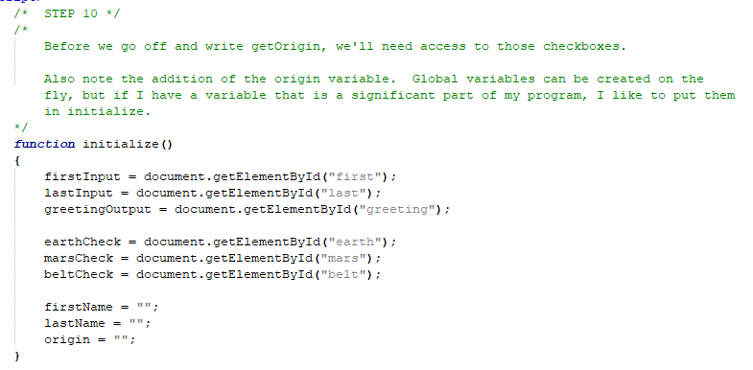
Construction

Slide 23
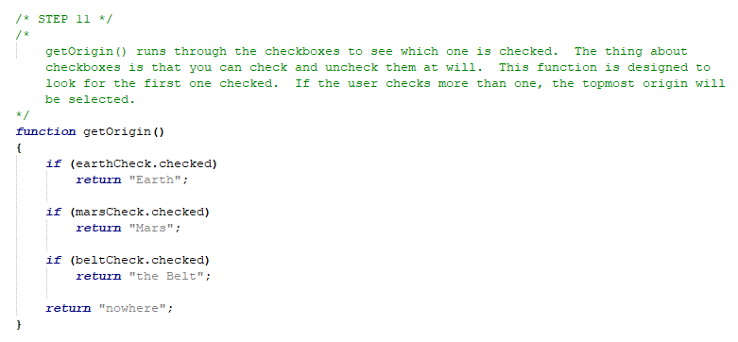
Construction

Slide 24
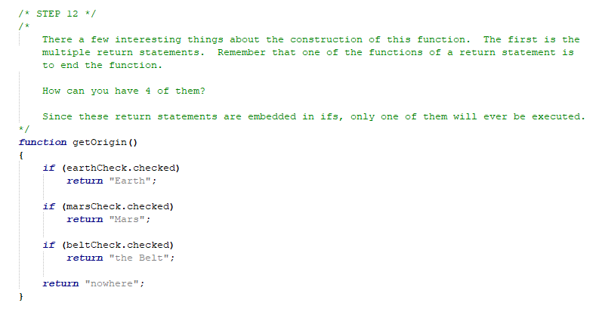
Construction

Slide 25
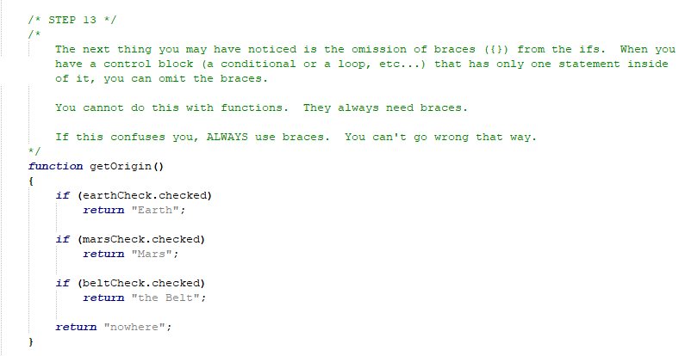
Construction

Slide 26
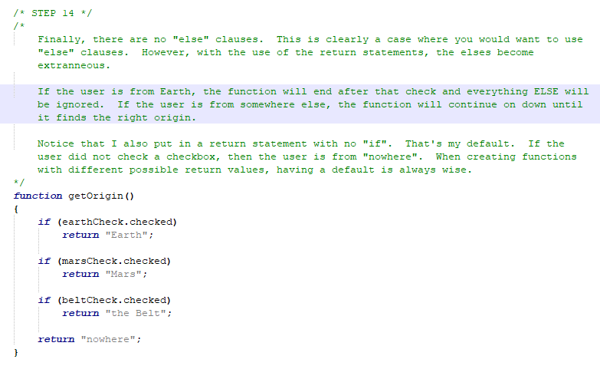
Construction

Slide 27
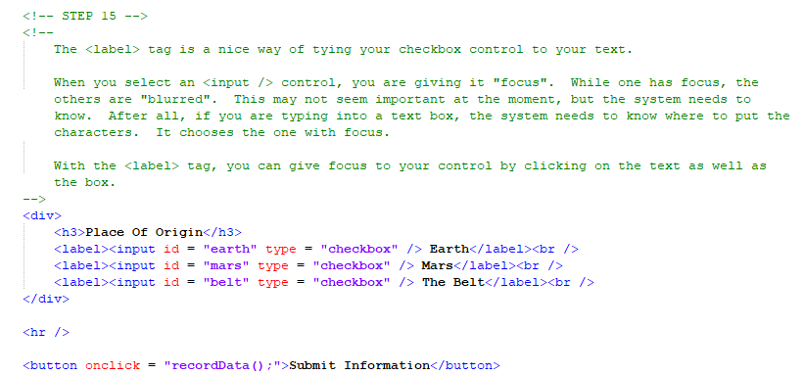
Construction

Slide 28
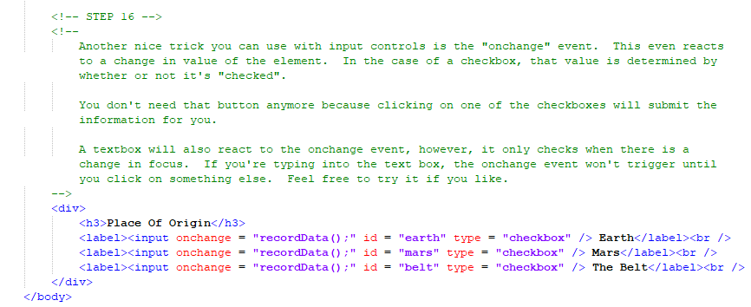
Construction

Slide 29
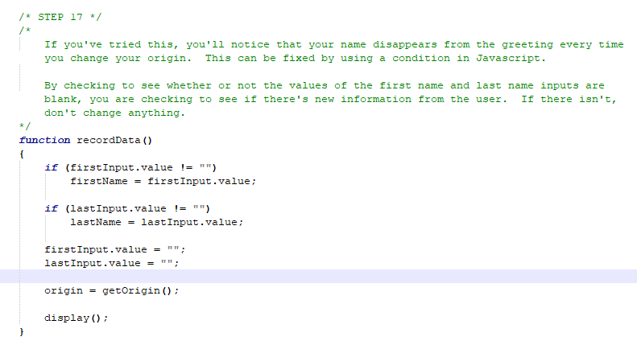
Construction

Slide 30
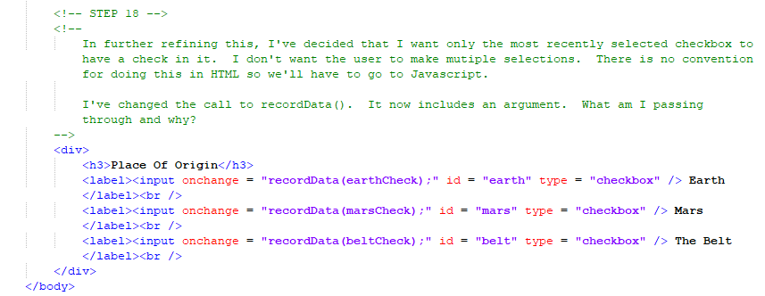
Construction

Slide 31
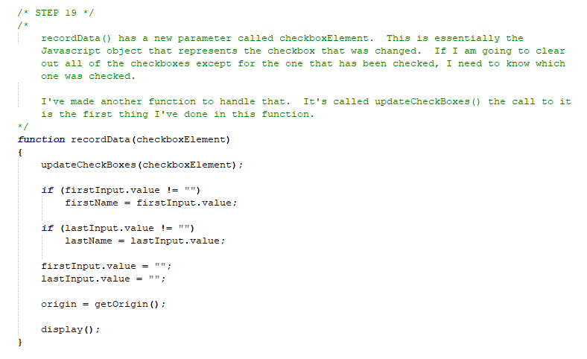
Construction

Slide 32
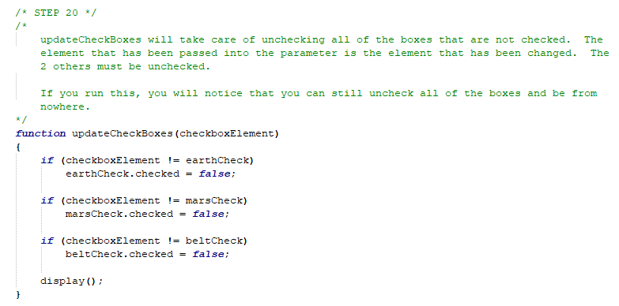
Construction

Slide 33
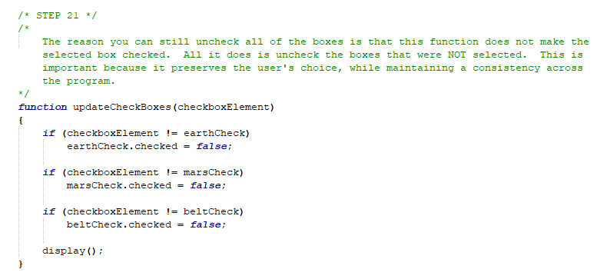
Construction

Slide 34
A DEEPER MEANING

Slide 35
A Deeper Meaning
Giving the user control of the information that flows through your program has its pluses and minuses. On the plus side, the user gets an experience that can be tailored to him or her. That keeps the user interested and engaged and you’ll have users coming back to your site again and again. On the minus side, there’s a real security issue. Users who don’t play nicely can do some real damage to your site. This can cause harm to your other users, which will ultimately result in the death of your site. You walk a fine line with user input.

Slide 36
A Deeper Meaning
Putting aside all of that, allowing dynamic user input comes with many programming challenges as well. It’s one thing to simply echo out what the user entered. It’s something else to be able to react to it. As programmers, the intuition of our end users challenges us to come up with better reaction algorithms. It becomes vital to master the language at its core, working with parameters and return values in order to manage this uncontrolled information flow.

Slide 37
A Deeper Meaning
Artificial intelligence is a hot field. There seems to be this crazy demand for making computers that can do our thinking for us. Between Alexa and Siri and Cortana, we’ve got operating systems that can talk to us. Siri doesn’t only know what a joke is, she can break it down into what kind of joke you want to hear. She can find a song on the internet. She can turn on your lights, lock your doors, and wake you up for work. She does all of this based on information we give her. At our level, we’re not going to do anything approaching Siri, but as you continue to write web pages and other programs, give some thought during planning on how you want them to react to the user. Think about what it might be like if, instead of a web page, there was a person interacting with the user. What questions would the user ask and what answers would the person give?

Slide 38
A Deeper Meaning
Can my web page do that?

Slide 39
A Deeper Meaning
I’ll bet it can.

Slide 40
FAQ

Slide 41
FAQ
Is Siri the first step toward Skynet?
I don’t think so. No matter how advanced our algorithms, artificial intelligence is still artificial. I like to think that the algorithms that our minds use are too complex for our minds to reproduce.

Slide 42
FAQ
What’s Skynet?
Skynet is the fictitious network that attacked humanity in the Terminator movies.

Slide 43
ACTIVITY

Slide 44
Conversation
Create a simple conversational page where the user will enter some information and the computer will respond to that information.
You should have a section for what the computer says, a text box and 3 checkboxes for user responses.
The first thing the computer will say is, “What is your name?”
When the user responds, the computer will say hello to the user, calling him or her by name.
The computer will proceed to ask the user three questions, one at a time. That can be whatever you like.
“How are you feeling?”
“What is your favorite color?”
“What new planets have you visited?”

Slide 45
Conversation
Each response should be either through the text box or one of the checkboxes. You can decide which questions require which responses, but there should be at least one of each.
The computer will respond to each answer and ask the next question. After responding to the third question, the computer will tell the user, once again referring to him or her by name, it has been nice chatting.
Bonus: If you want to prevent the user from clicking checkboxes for text answers or entering text for checkbox answers, you can do this by setting the disabled property of the appropriate HTML elements. If an element’s disabled property is set to true, that element cannot gain focus.

